Slide 1
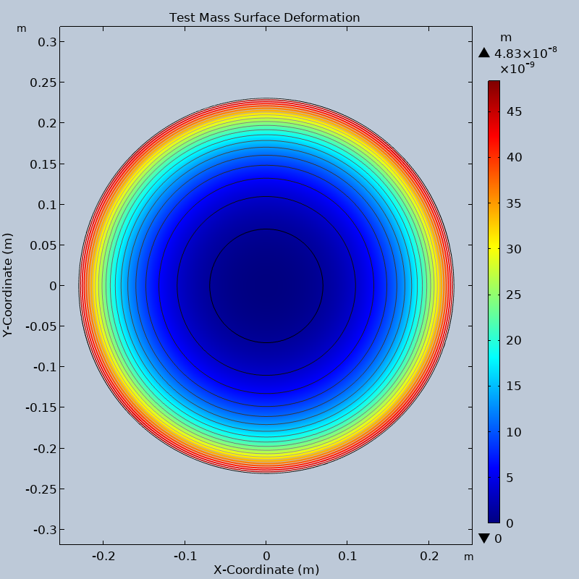
This deformation is due to the revolution of the interpolated data.

Slide 2
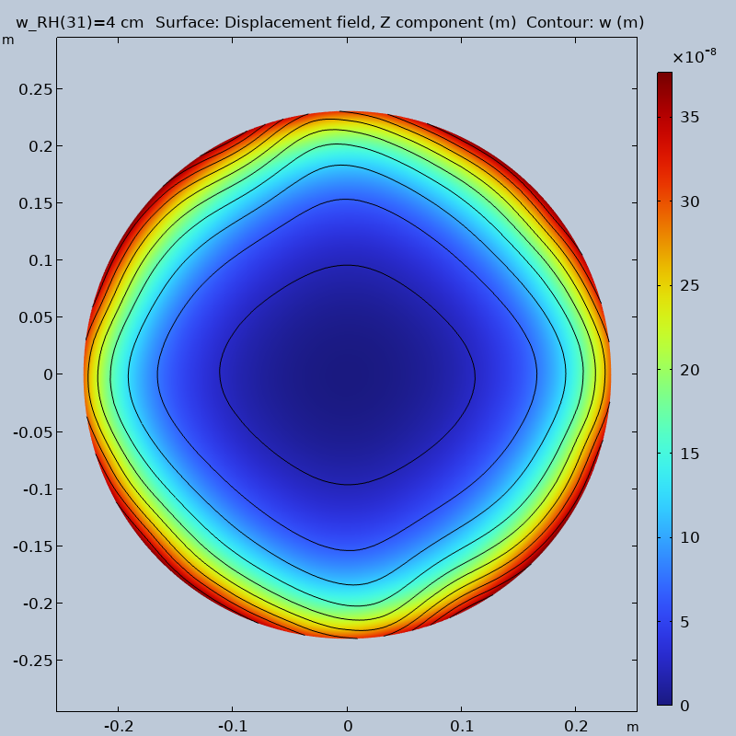
This deformation is from a simple top hat function but for some reason I have been getting weird deformations.
I believe that it is due to some changes I made to the model
I would like to just pull the backup file from git.
Is there any specific thing I need to do.

Slide 3
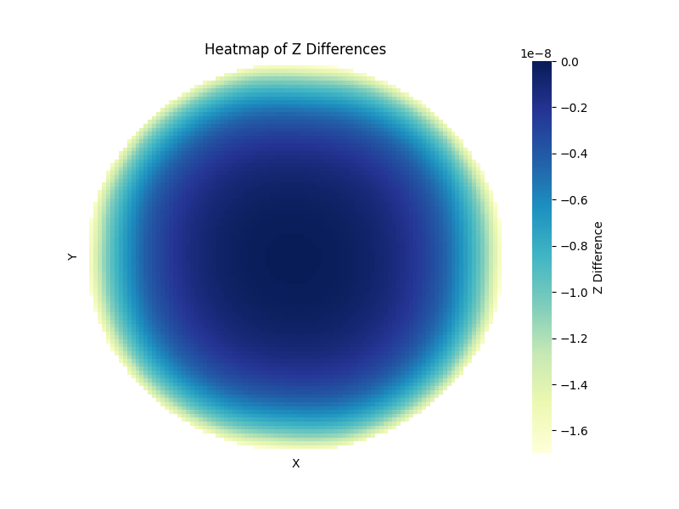
(Defined - Interpolated)
While the magnitude of the surface deformation is different the symmetry of it is encouraging.
In the future would you like me to use 1D plots to represent this difference? As sometimes it is hard to tell what this plot is showing.

Slide 4
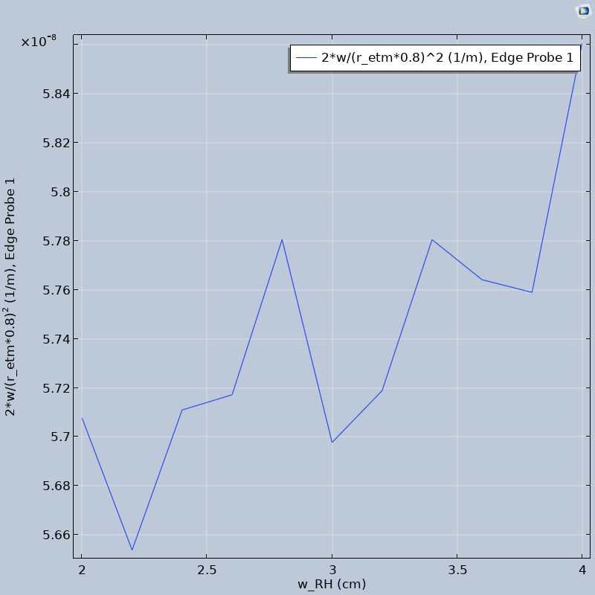
I defined a edge on the surface of the test mass at 0.8 of the radius. On this edge I found the average height then using D = 2*z/(R^2) to find the curvature if the deformation is quadratic.

Slide 5
I have tried to narrow down where all of the power is being released to. While I have not found all 100W of the power I was able to find a few things.
First I created a virtual wall to measure the power coming out of the elliptical surfaces. This was about 20-21W. I then measured how much power incidented on the different surfaces. The elliptical surfaces only absorb about 0.3W and the release point absorbs about 1.5W.
I was also able to measure the total power that would normally land on the test mass and it was close to the power I calculated around 18.5W.
I did get a warning in comsol that some rays were terminated
I tried a few things to see their effects.
I changed the shape of the elliptical mirrors, minimal change.
I increased the number of secondary rays by a lot, minimal change.

Slide 6
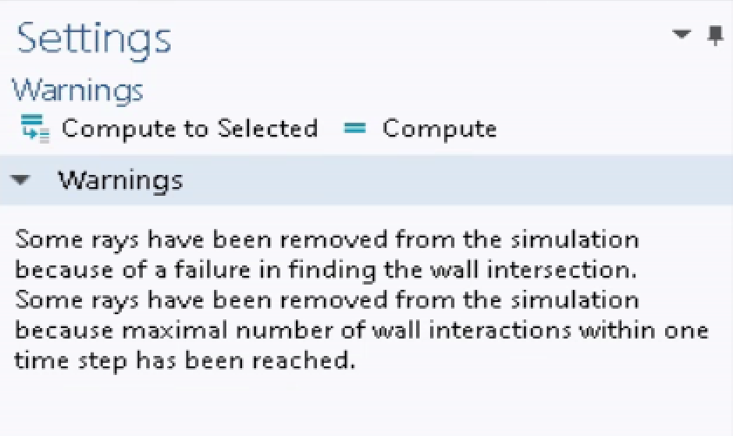
I believe this is where I am losing rays. I am not exactly sure how to fix it.

Slide 7
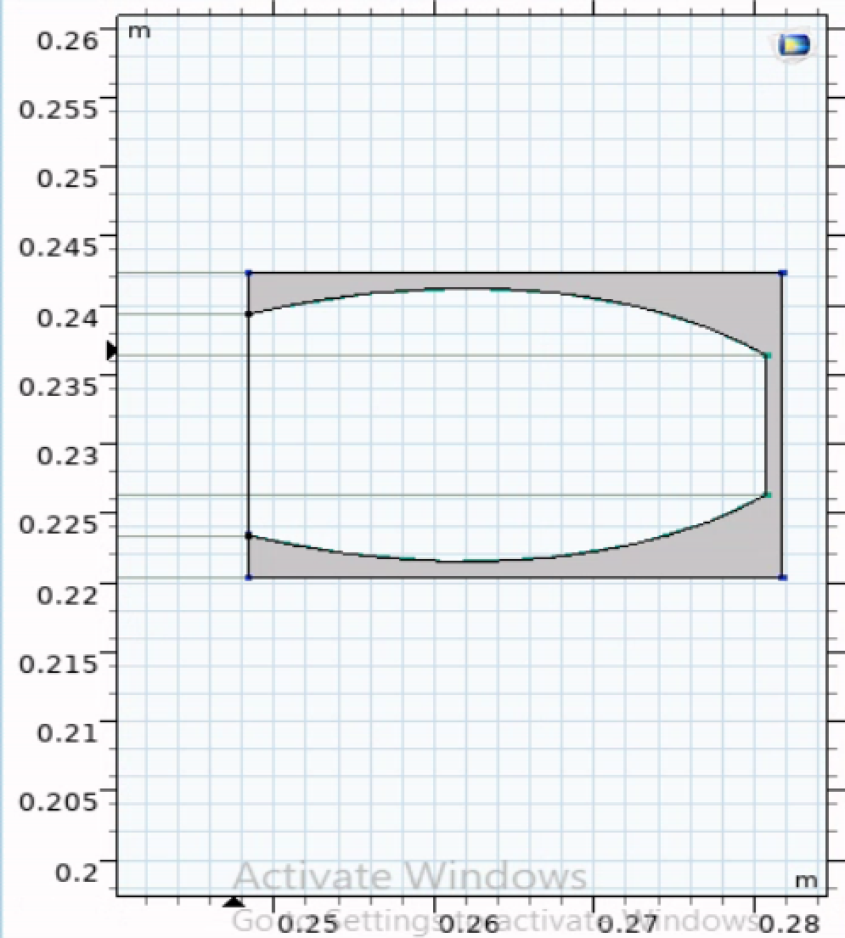
Here is a side profile of the elliptical mirrors. I currently have a closing wall enabled to test how much of the power makes it out of the reflectors.

