Slide 1
Ringheater Updates

Slide 2
Table of contents
Changes to Ringheater model that improved HR surface deformation
Azimuthal Interpolation and Integration of irradiance data
Next steps / Thoughts

Slide 3
Updates to Model

Slide 4
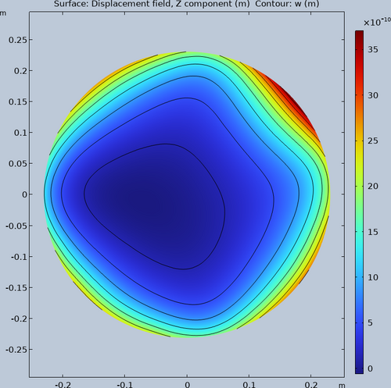
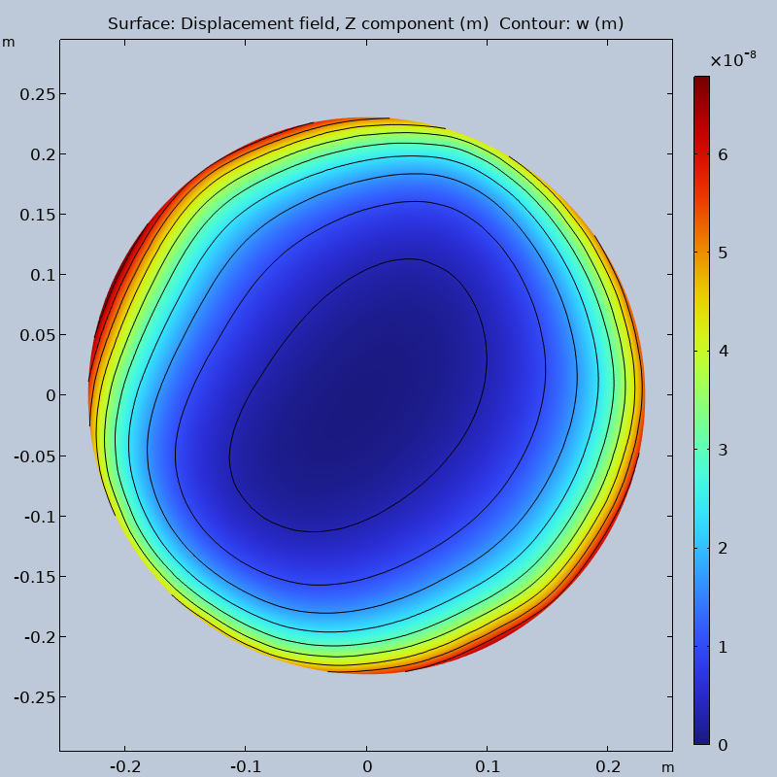
Initial After removing edges of release surfaces
Notes:
The left graph was what the surface deformation looked like while the ray release surface was broken up into 4 segments. The right was after the segments were removed.

Slide 5
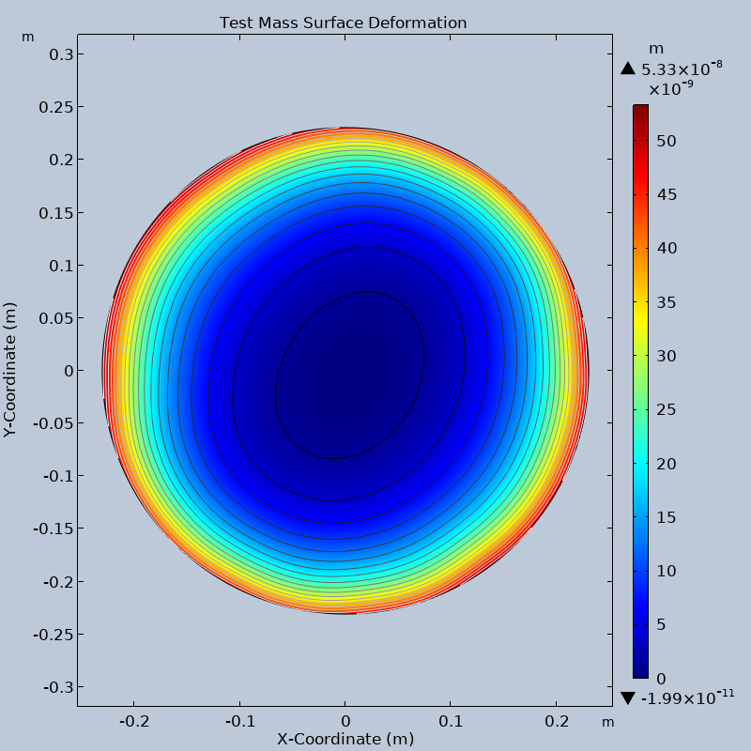
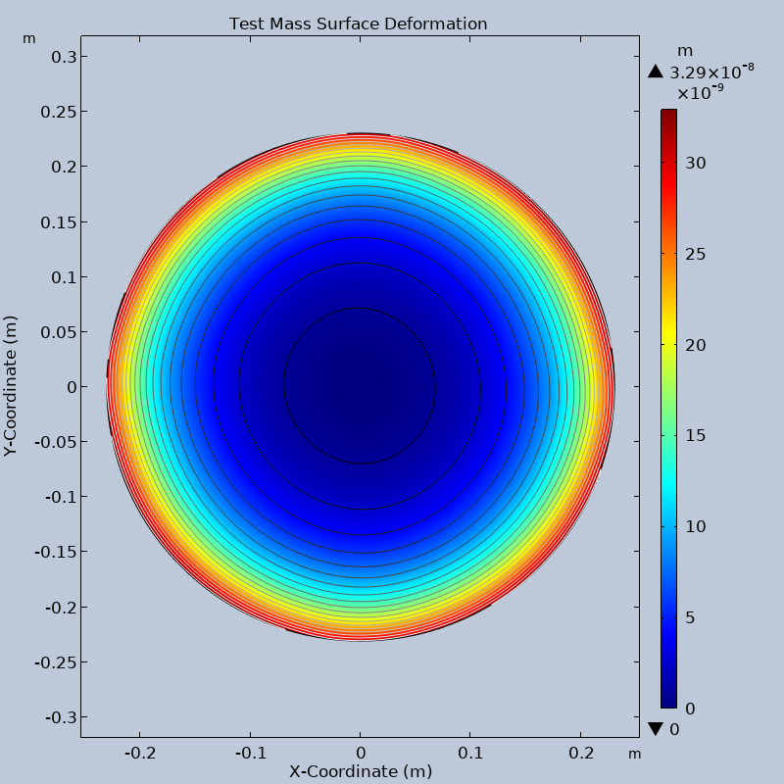
Ray tracing Defined Irradiance
Notes:
The left is taking the ray tracing irradiance data and importing it onto the thermal stress model. The right uses a defined irradiance with a top hat distribution.

Slide 6
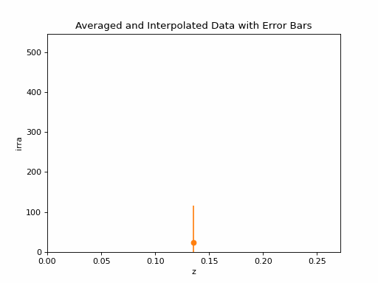
Interpolation work

Slide 7
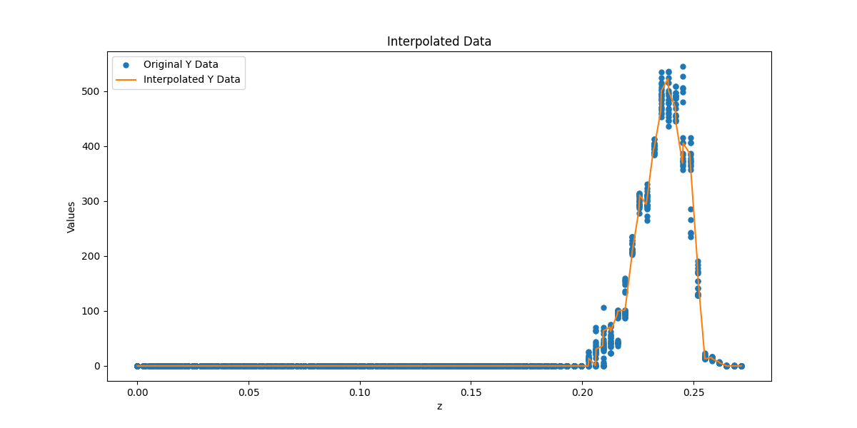
I took the Irradiance data exported from the ringheater model and graphed z vs. Irradiance. I completely ignored the x and y components so that I could look at only its azimuthal properties.

Slide 8
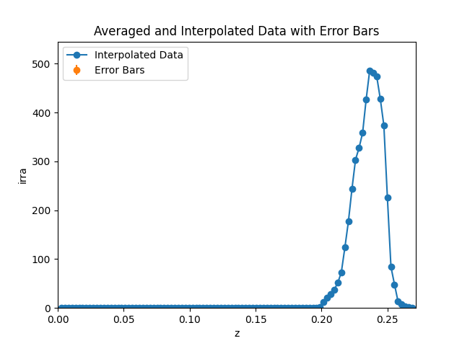
After I got an initial interpolation of the data I broke the data up into bins along the z axis so that I could average the Irradiance of the bins to get a smoother graph.
The graph seen here was broken into 50 bins.

Slide 9
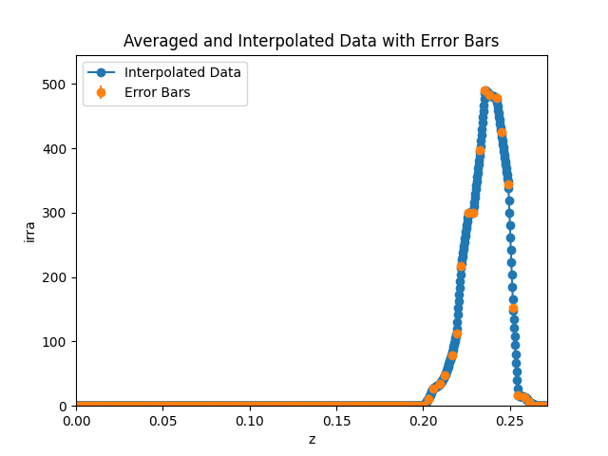
The graph seen here is broken into 200 bins.
I have also integrated this interpolated data and the area under this curve is 12.9361 W/m
To find total power we multiply by 2*Pi*Radius of the TM.
Which equals 18.7537 W
I have the model setup to release 100W of power this would mean that the efficiency is only 18.75%

Slide 10
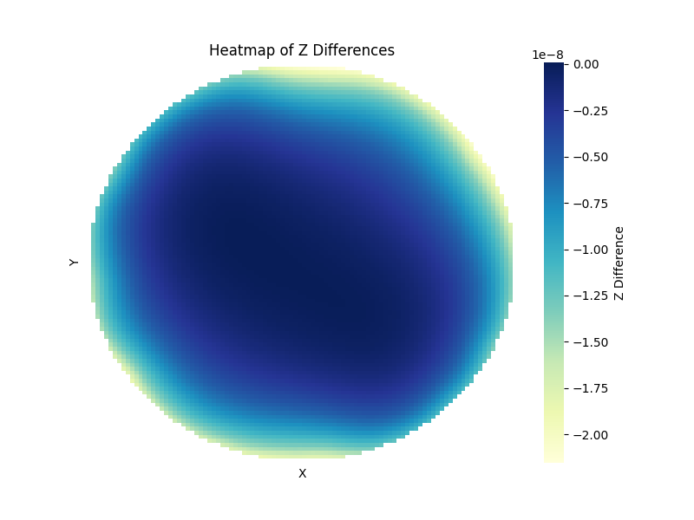
Here is a plot of the difference between the two surface deformations.
(Defined - Raytrace)
The release power of the raytrace is the same as the total power for the defined irradiance.
As seen here the raytrace actually causes more surface deformation on some parts of the HR surface.

Slide 11
My thoughts on next steps
First I need to identify where this poor efficiency comes from
Is it a problem from the actual integration?
From rays just missing the test mass?
Or are some of the surfaces of the model defined poorly such that to many rays are being absorbed?
Taking this interpolated data and bringing it back into COMSOL to see how it measures up to the top hat distribution.

